Slide 1
Payment products
POS , PP and PR

Slide 2
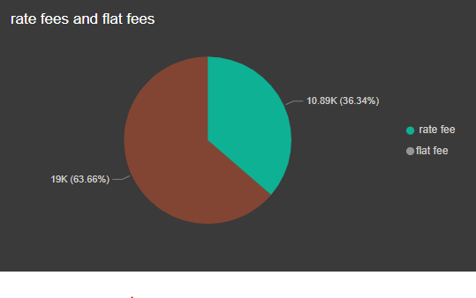
POS
Rate fee = 1% flat fee = 2$ Number of transactions = 9540
(29.1% of all transactions) avg of each transaction = 3.14 $ total rate fees = 10893.90
(1.57% of total rate fees ) total flat fees = 19080
( 60.86% of total flat fees ) Total fees = 29973.90 $
(4.13% of Total fees )
Growth rate = 175%

Slide 3
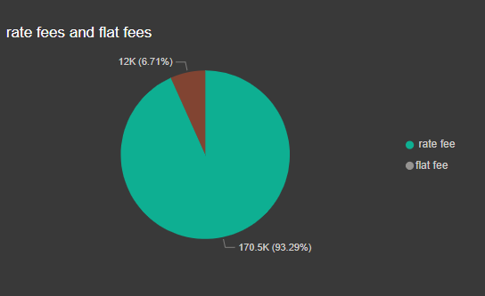
PP
Rate fee = 2.5% flat fee = 2$ Number of transactions = 6133
(18.71% of all transactions) avg of each transaction = 29.80 $ total rate fees = 170501.85
(24.56% of total rate fees ) total flat fees = 12266
( 39.13% of total flat fees ) Total fees = 182767.85 $
(25.2% of Total fees )
Growth rate = 90.48%

Slide 4
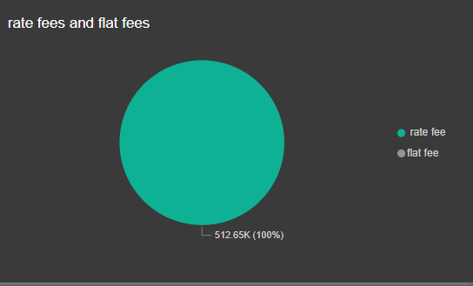
PR
Rate fee = 3% flat fee = 0$ Number of transactions = 17112
(52.19% of all transactions) avg of each transaction = 29.96 $ total rate fees = 512650.32
(73.86% of all total fees ) total flat fees = 0% zero flat fees Total fees = 512650.32 $
(70.67% of Total fees )
Growth rate = 17.57%

Slide 5
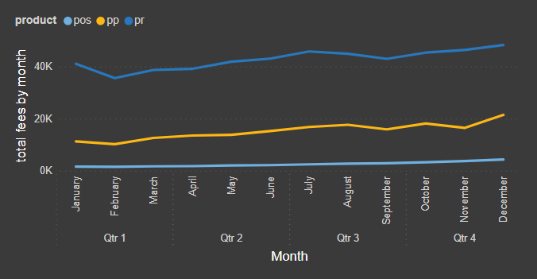
the recommendation would be to allocate more resources to Payment Requests (PR).
It has the highest revenue 512650.32 $ (70.67% of Total revenue )
It has a reasonable growth rate 17.57%
It has the highest average revenue per transaction 29.96
By focusing on Payment Requests, Kashier can potentially increase revenue, improve profitability, and leverage the existing growth rate to further enhance market share and customer satisfaction.

